Slide 1




NEXT GEN EMPLOYABILITY PROGRAM
Creating a future-ready workforce
Team Members
College Name
Student Name: Sowmiya G
Student ID : 511321205038
Kingston Engineering College

Slide 2

CAPSTONE PROJECT SHOWCASE
Project Title
Building Bus Reservation System using Python and Django
Abstract | Problem Statement | Project Overview | Proposed Solution | Technology Used | Modelling & Results | Conclusion

Slide 3
Abstract
Objective: Simplify bus ticket booking with an intuitive online platform.
Features:
User Registration & Authentication
Bus Routes Management
Seat Selection
Booking Management
Payment Integration
Admin Panel
Tech Stack:
Python
Django
HTML/CSS
Source :

Slide 4
Problem Statement
Building a Bus Reservation System using Python and Django
Source :

Slide 5
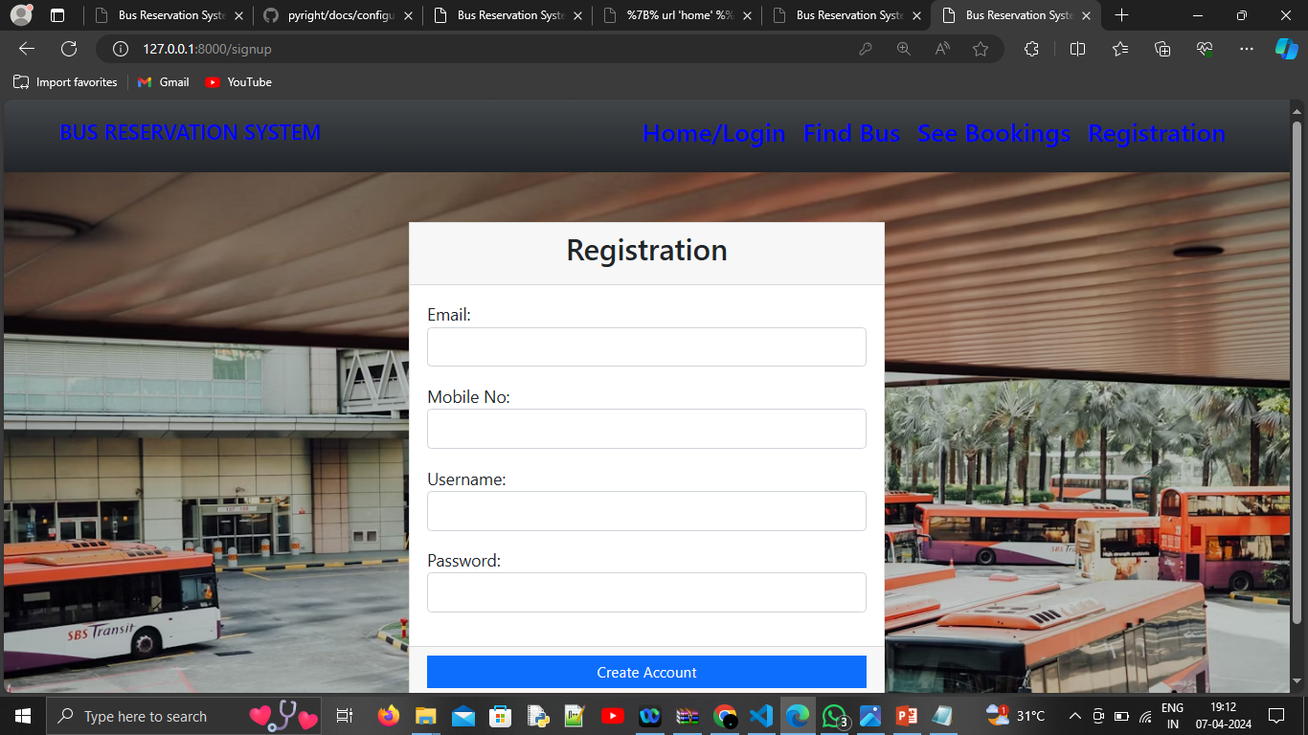
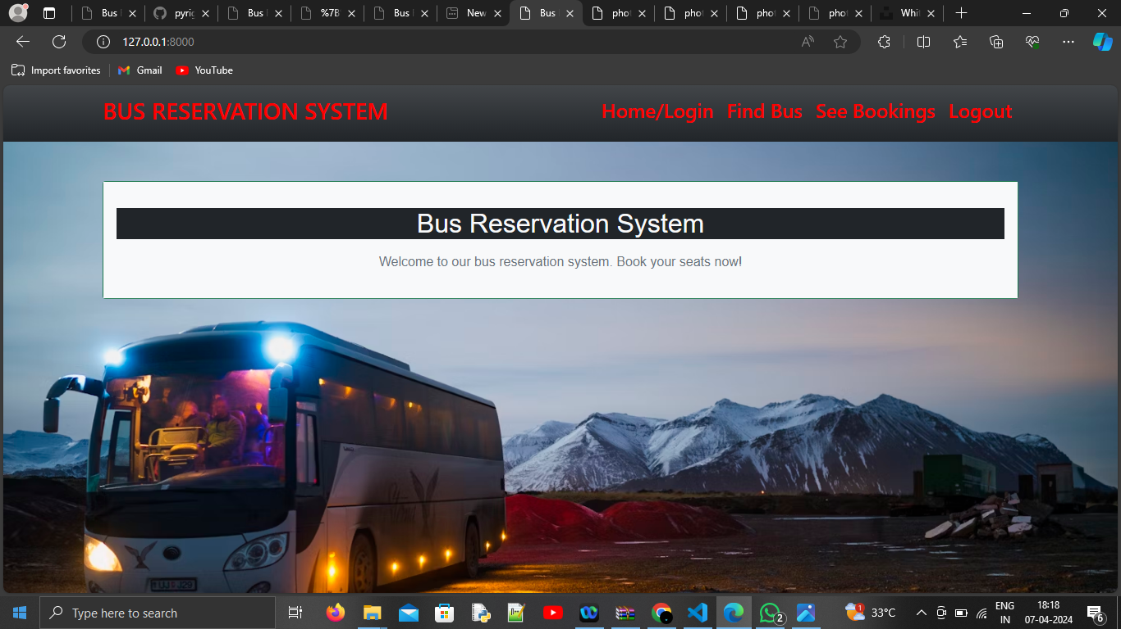
Project Overview
Source :

Slide 6
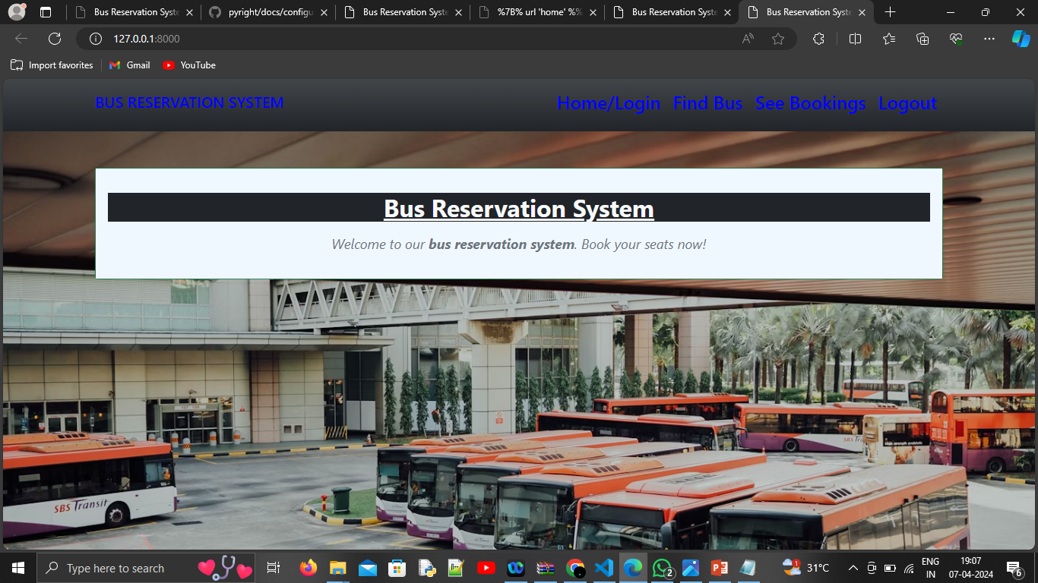
Proposed Solution
.
Source :

Slide 7
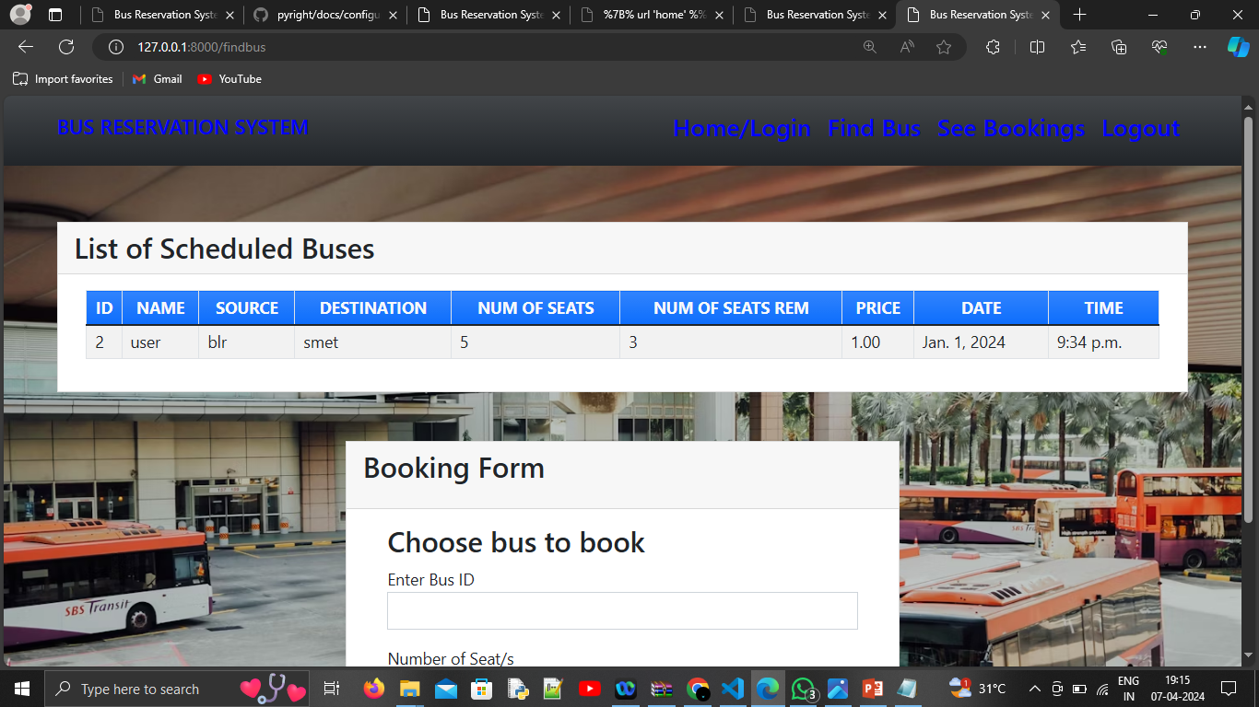
Source :

Slide 8
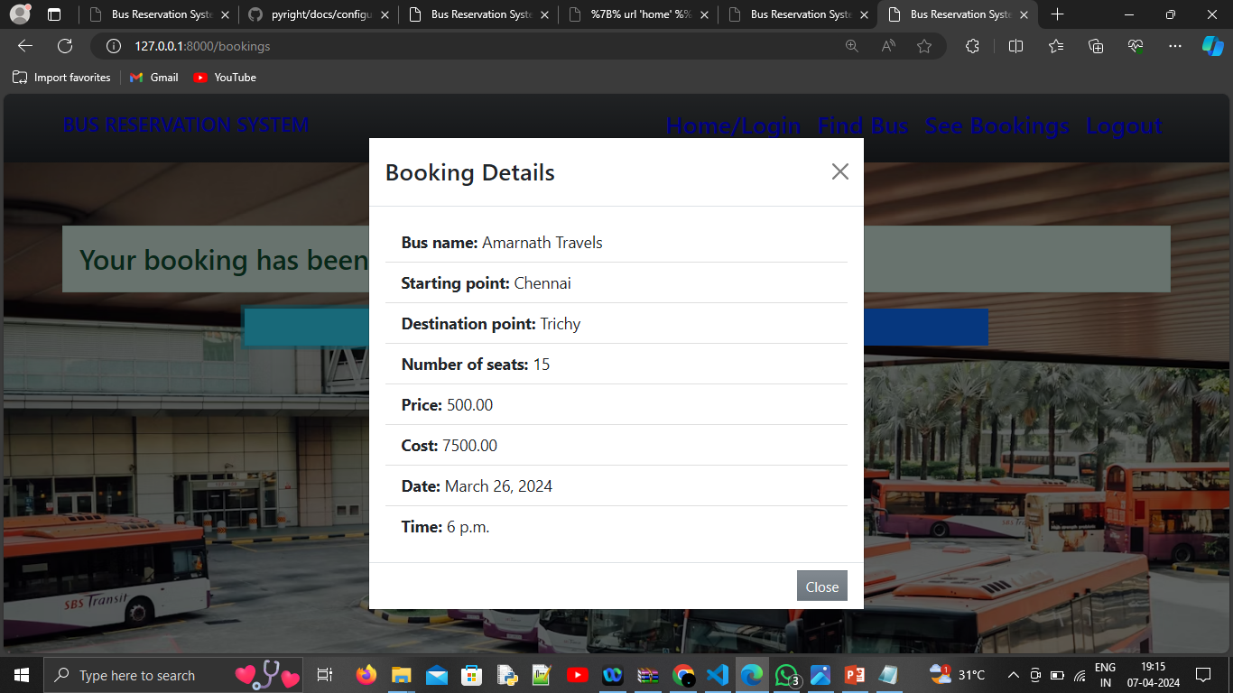
Source :

Slide 9


Technology Used
Front-end
Back-end
Source :

Slide 10
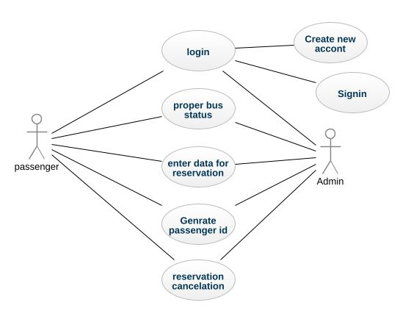
Modelling & Results
Source :

Slide 11
Homepage
1. Welcome to our Bus Reservation System!
2. Search for available bus routes by entering your departure and destination.
3. Explore featured routes and special promotions for great travel deals.
4. Register now or log in to access your account and make bookings.
5. Learn more about our service and how it works.
6. Need help? Contact our customer support for assistance.
7. Read testimonials from satisfied customers about their experiences.
8. Connect with us on social media for updates and travel tips.
9. Footer contains links to important pages like Terms of Service.
10. Enjoy a hassle-free booking experience and start your journey today!

Slide 12
About-Us-Page
1. Welcome to Our Bus Reservation System!
2. Our Mission: Simplifying Bus Travel for Everyone
3. Company Overview: Who We Are and What We Do
4. Meet Our Team: Dedicated Experts in Customer Satisfaction
5. Core Values: Transparency, Reliability, Customer-Centricity
6. Services: Seamless Booking, Extensive Route Coverage, 24/7 Support
7. Customer Satisfaction: Testimonials from Happy Travelers
8. Community Engagement: Making a Positive Impact Beyond Travel
9. Innovation: Continuous Improvement for Better Travel Experiences
10. Contact Us: Reach Out for Inquiries, Feedback, or Support
11. FAQs: Quick Answers to Common Questions
12. Partnerships: Collaborating for Enhanced Service Delivery
13. Careers: Join Our Team and Be Part of Our Journey
14. Social Media: Stay Connected for Updates and Promotions
15. Thank You for Choosing Us!

Slide 13
Service-Page
1. Welcome to Our Services Page!
2. Explore Our Comprehensive Range of Offerings
3. Booking: Effortlessly Reserve Bus Tickets Online
4. Route Coverage: Extensive Network Across Various Destinations
5. Seat Selection: Choose Your Preferred Seat with Ease
6. Payment Options: Secure and Convenient Payment Methods
7. Customer Support: 24/7 Assistance for Any Queries or Concerns
8. Special Packages: Discover Exciting Deals and Discounts
9. Group Bookings: Convenient Booking Options for Groups
10. Flexible Cancellation: Hassle-Free Cancellation and Refund Process
11. Real-Time Updates: Stay Informed About Your Journey
12. Accessibility: User-Friendly Interface for Seamless Navigation
13. Quality Assurance: Ensuring Reliable and Comfortable Travel
14. Personalized Experience: Tailored Services to Meet Your Needs
15. Thank You for Choosing Us for Your Travel Needs!

Slide 14
Departments-Page
1. Welcome to Our Departments Page!
2. Overview: Learn About Our Organizational Structure
3. Administration: Responsible for Overall Management and Operations
4. Customer Service: Dedicated to Providing Exceptional Support
5. Sales and Marketing: Driving Business Growth and Outreach
6. Technology: Innovating and Enhancing Our Digital Platforms
7. Finance: Managing Financial Operations and Resources
8. Human Resources: Nurturing Talent and Employee Development
9. Logistics: Ensuring Smooth Coordination of Services
10. Quality Assurance: Upholding Standards and Customer Satisfaction
11. Research and Development: Driving Innovation and Improvement
12. Collaboration: Emphasizing Cross-Departmental Cooperation
13. Communication: Facilitating Effective Internal and External Communication
14. Sustainability: Promoting Environmental Responsibility Across Departments
15. Thank You for Exploring Our Departments!

Slide 15
Blog-Page
1. Welcome to Our Blog Page!
2. Overview: Explore Our Latest Articles and Insights
3. Featured Posts: Highlighting Our Most Popular and Relevant Content
4. Categories: Browse Articles by Topic for Easy Navigation
5. Recent Posts: Stay Up-to-Date with Our Newest Content
6. Author Profiles: Meet the Writers Behind the Articles
7. Comment Section: Engage with Other Readers and Share Your Thoughts
8. Search Bar: Find Specific Articles or Topics Quickly
9. Subscription: Sign Up to Receive Notifications for New Blog Posts
10. Sharing Options: Share Articles on Social Media or via Email
11. Related Posts: Discover Similar Articles for Further Reading
12. Multimedia: Enjoy Videos, Infographics, and Interactive Content
13. Trending Topics: Explore Current Trends and Discussions
14. Call to Action: Encouraging Readers to Explore More Content or Contact Us
15. Thank You for Visiting Our Blog!

Slide 16
Future Enhancements:
1. Continuous Improvement: Commitment to Enhancing User Experience
2. Mobile Application Development: Introducing a Mobile App for On-the-Go Booking
3. Loyalty Program: Rewarding Repeat Customers with Exclusive Benefits
4. Integration with Travel Partners: Collaborating with Airlines and Hotels for Seamless Travel Packages
5. Advanced Seat Selection: Implementing Interactive Seat Maps for Better User Control
6. Real-Time Tracking: Providing Live Updates on Bus Locations and Arrival Times
7. Multilingual Support: Offering Services in Multiple Languages for Global Accessibility
8. Virtual Reality Tours: Enabling Virtual Tours of Buses and Destinations for Enhanced Experience
9. AI-Powered Assistance: Implementing Chatbots for Instant Customer Support
10. Eco-Friendly Initiatives: Investing in Green Technologies and Sustainable Practices
11. Enhanced Security Measures: Strengthening Data Protection and Fraud Prevention
12. Community Engagement Programs: Supporting Local Communities and Initiatives
13. Voice Command Integration: Allowing Users to Book Tickets via Voice Commands
14. Personalized Recommendations: Utilizing Machine Learning to Offer Tailored Travel Suggestions
15. Stay Tuned for Exciting Updates and Innovations!

Slide 17
Conclusion
1. Recap: Summarizing Our Journey and Achievements
2. Successes: Celebrating Milestones and Accomplishments
3. Gratitude: Thanking Our Customers, Partners, and Team Members
4. Commitment: Reaffirming Our Dedication to Providing Exceptional Service
5. Feedback: Welcoming Feedback and Suggestions for Improvement
6. Looking Ahead: Exciting Opportunities and Challenges on the Horizon
7. Growth: Continuing to Grow and Evolve in the Industry
8. Vision: Striving Towards Our Vision of Simplifying Travel for Everyone
9. Collaboration: Emphasizing the Importance of Collaboration and Partnerships
10. Innovation: Commitment to Innovation and Continuous Improvement
11. Stay Connected: Keeping in Touch for Future Updates and Enhancements
12. Thank You: Expressing Sincere Gratitude for Being Part of Our Journey
13. Together, Let's Create a Better Future of Travel!
14. Contact Us: Reach Out for Any Inquiries or Collaborations
15. Farewell and Safe Travels!
Source :

Slide 18
Thank You!
Notes:
Thank You !!

